Slide 1
Lab 11

Slide 2
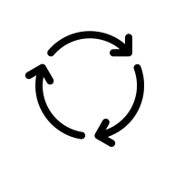
Directed Graph – Cycle Detection
Task: Write a Python function named extractCycle(graph, start).
Input: An adjacency list representing a directed graph and a start node.
Output: If the ‘start’ node is part of a cycle, return the cycle as a list of nodes.
Otherwise, return an empty list.
For example, when the method is called with the following graph with start=0,
it should return [0, 1, 2, 4, 0]
0
1
2
3
4
5
Hints: DFS

Slide 3
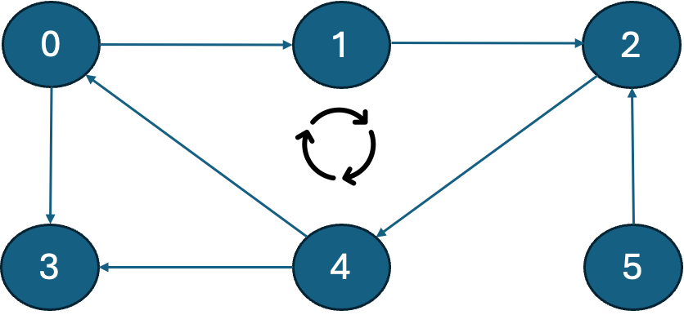
Example Code:
#Adjacency list representing the graph
adj = [
[1,3],
[2],
[4],
[],
[0,3],
[2]
]
def extract_cycle(adj_list, start):
#TODO: Implement this method
print(extract_cycle(adj, 0)) # Should print [0, 1, 2, 4, 0]
print(extract_cycle(adj, 1)) # Should print [1, 2, 4, 0, 1]
print(extract_cycle(adj, 3)) # Should print []

Slide 4
Submission Instructions
Submit the following in iCollege:
  Python script/solution (FULL_NAME_Lab11.py)
Due date/time for submission: Within 24 hours from your lab’s end time.
Lab attendance is mandatory. Your iCollege submission will only be considered for grading if you attend the corresponding lab session in-person.
Be prepared to answer a couple of questions on your solution/partial solution during the lab session.

